Slide 1
Cornerstone City Church Peninsula Plus Community Hoo Are Ya
12th November 2023

Slide 2
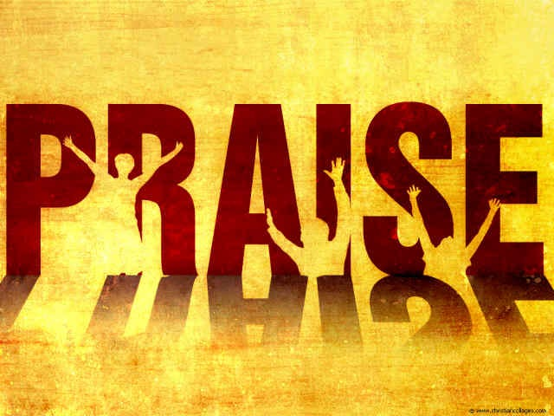

Slide 3
Great Big God
CCLI Song # 3373437
Jo Hemming | Nigel Hemming
© 2001 Vineyard Songs (UK/Eire) (Admin. by Integrity Music Ltd)
For use solely with the SongSelect® Terms of Use. All rights reserved. www.ccli.com
CCLI Licence No. 33265

Slide 4
1/2
Our God is a great big God
Our God is a great big God
Our God is a great big God
And He holds us in His hands

Slide 5
2/2
He's higher than a skyscraper
And He's deeper than a submarine
He's wider than the universe
And beyond my wildest dreams
And He's known me and He's loved me
Since before the world began
How wonderful to be a part of
God's amazing plan

Slide 6
Show Your Power
CCLI Song # 861891
Kevin Prosch
© 1991 Mercy / Vineyard Publishing (Admin. by Integrity Music Ltd)
For use solely with the SongSelect® Terms of Use. All rights reserved. www.ccli.com
CCLI Licence No. 33265

Slide 7
1/4
Well He is the Lord He reigns on high
He is the Lord
Spoke into the darkness created the light
He is the Lord
Who is like unto Him never ending in days
He is the Lord
And He comes in power when we call on His name
He is the Lord

Slide 8
2/4
Show Your power oh Lord our God
Show Your power oh Lord our God
Oh Lord our God

Slide 9
3/4
Your gospel oh Lord is the hope for our nation
You are the Lord
It's the power of God for our salvation
You are the Lord
We ask not for riches but look to the cross
You are the Lord
And for our inheritance give us the lost
You are the Lord

Slide 10
4/4
Show Your power oh Lord our God
Show Your power oh Lord our God
Oh Lord our God

Slide 11
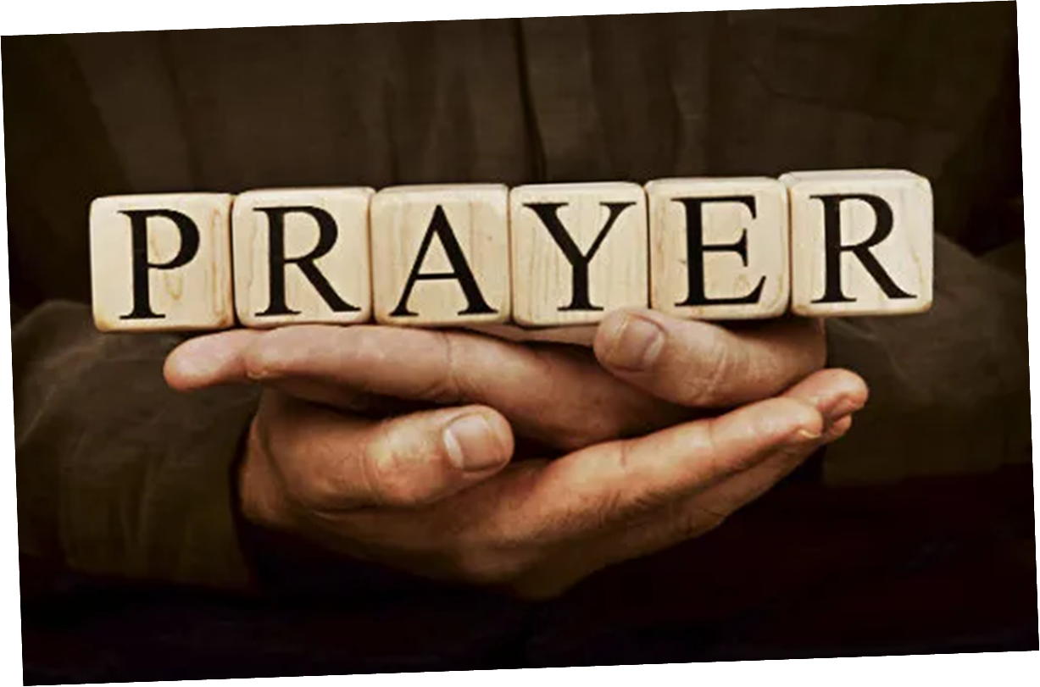

Slide 12
10,000 Reasons
CCLI Song # 6016351
Jonas Myrin | Matt Redman
© 2011 Thankyou Music (Admin. by Integrity Music Ltd)
Atlas Mountain Songs (Admin. by SHOUT! Music Publishing UK)
For use solely with the SongSelect® Terms of Use. All rights reserved. www.ccli.com
CCLI Licence No. 33265

Slide 13
1/7
Bless the Lord O my soul O my soul
Worship His holy name
Sing like never before O my soul
I'll worship Your holy name

Slide 14
2/7
The sun comes up it's a new day dawning
It's time to sing Your song again
Whatever may pass and whatever lies before me
Let me be singing when the evening comes

Slide 15
3/7
Bless the Lord O my soul O my soul
Worship His holy name
Sing like never before O my soul
I'll worship Your holy name

Slide 16
4/7
You're rich in love and You're slow to anger
Your name is great and Your heart is kind
For all Your goodness I will keep on singing
Ten thousand reasons for my heart to find

Slide 17
5/7
Bless the Lord O my soul O my soul
Worship His holy name
Sing like never before O my soul
I'll worship Your holy name

Slide 18
6/7
And on that day when my strength is failing
The end draws near and my time has come
Still my soul will sing Your praise unending
Ten thousand years and then forevermore

Slide 19
7/7
Bless the Lord O my soul O my soul
Worship His holy name
Sing like never before O my soul
I'll worship Your holy name

Slide 21
King of My Heart
CCLI Song # 7046145
John Mark McMillan | Sarah McMillan
© 2015 Meaux Jeaux Music; Raucous Ruckus Publishing; Sarah McMillan Publishing
For use solely with the SongSelect® Terms of Use. All rights reserved. www.ccli.com
CCLI License # 33265

Slide 22
1/5
Let the King of my heart
Be the mountain where I run
The fountain I drink from
Oh He is my song
Let the King of my heart
Be the shadow where I hide
The ransom for my life
Oh He is my song

Slide 23
2/5
You are good good oh
You are good good oh
You are good good oh
You are good good oh

Slide 24
3/5
Let the King of my heart
Be the wind inside my sails
The anchor in the waves
Oh He is my song
Let the King of my heart
Be the fire inside my veins
The echo of my days
Oh He is my song

Slide 25
4/5
You're never gonna let
Never gonna let me down
You're never gonna let
Never gonna let me down
You're never gonna let
Never gonna let me down
You're never gonna let
Never gonna let me dow

Slide 26
5/5
When the night is holding on to me
God is holding on
When the night is holding on to me
God is holding on

Slide 28
Breathe (This is the Air) CCLI Song # 1874117
Marie Barnett
© 1995 Mercy / Vineyard Publishing
For use solely with the SongSelect® Terms of Use. All rights reserved. www.ccli.com
CCLI License # 33265

Slide 29
1/3
This is the air I breathe
This is the air I breathe
Your holy presence living in me
This is my daily bread
This is my daily bread
Your very word spoken to me

Slide 30
2/3
And I I'm desperate for You
And I I'm lost without You

Slide 31
3/3
This is the air I breathe
This is the air I breathe
This is the air I breathe
This is the air I breathe

Slide 32


Slide 33
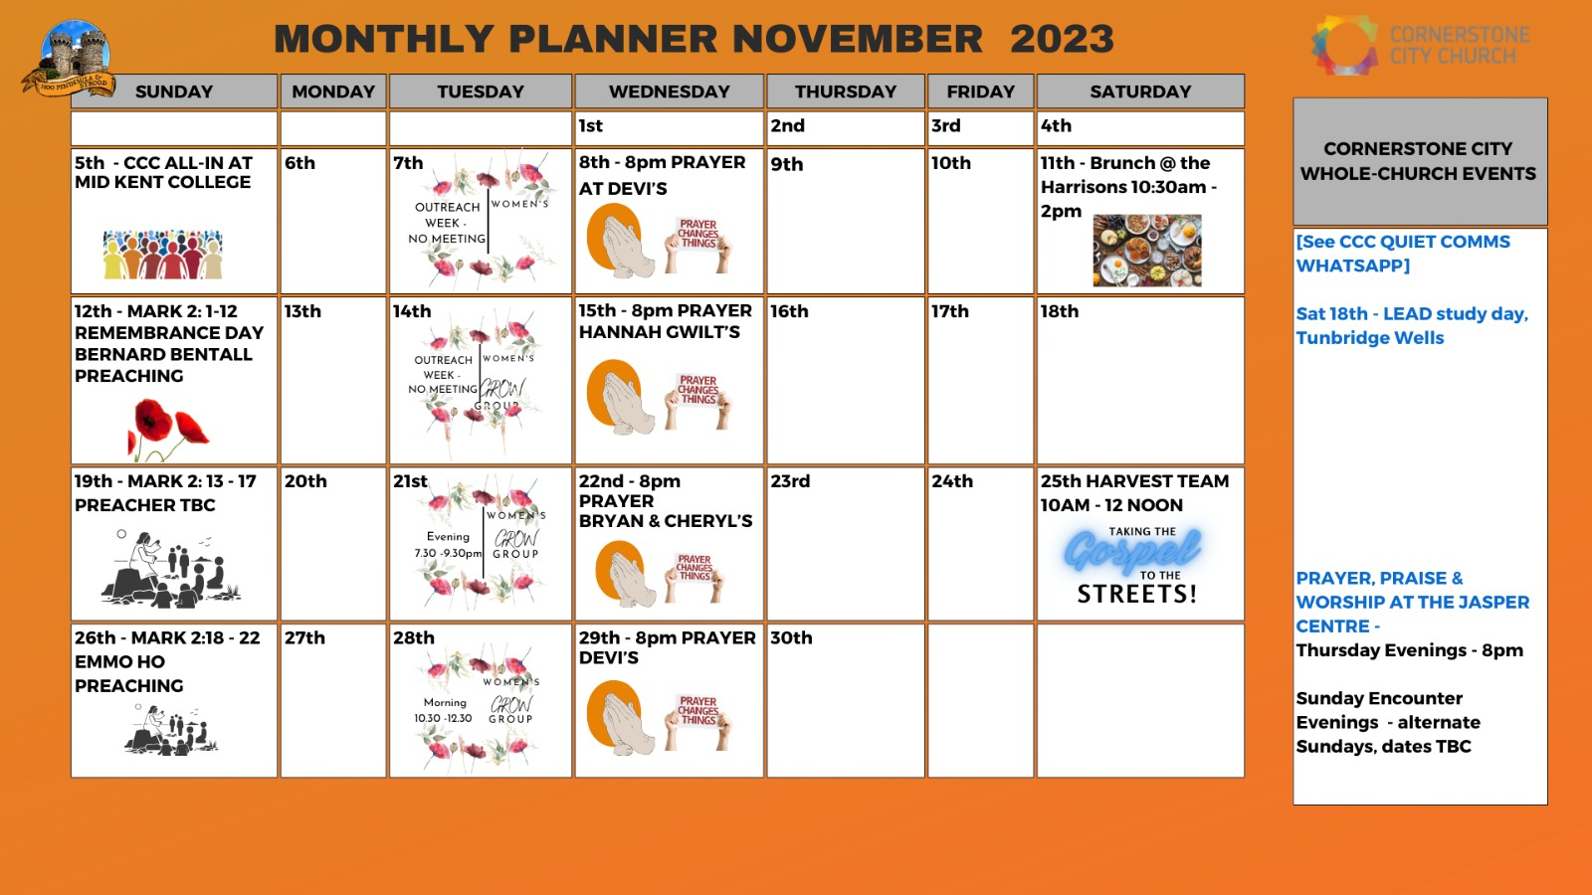

Slide 34


Slide 35
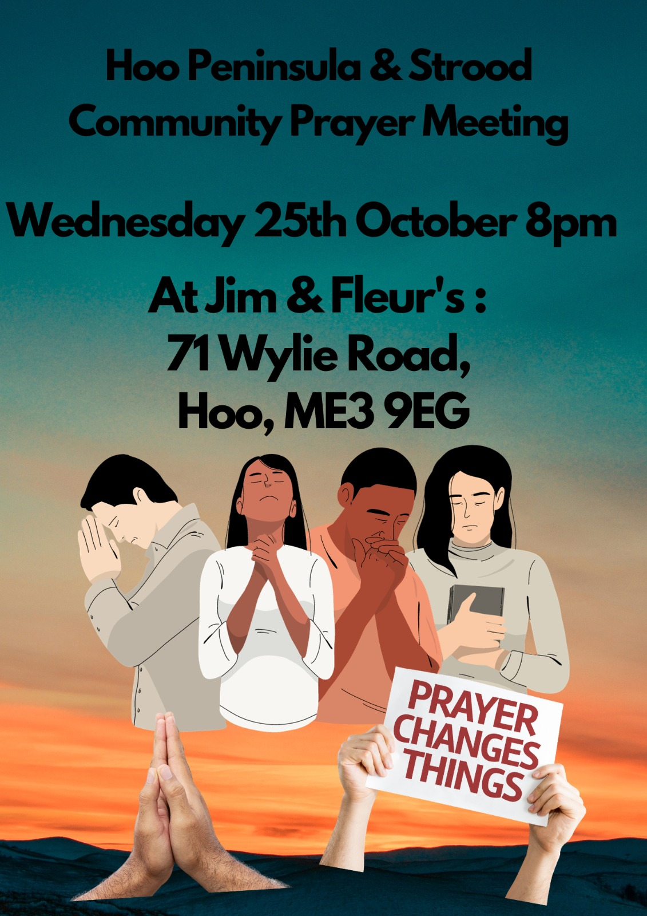

Slide 40
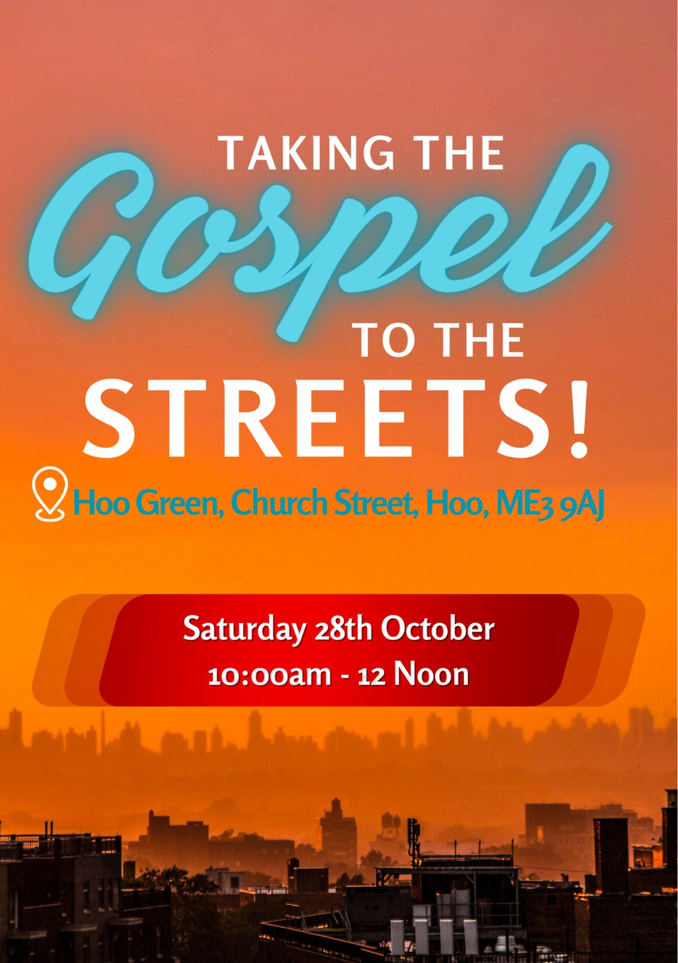

Slide 41


Slide 42
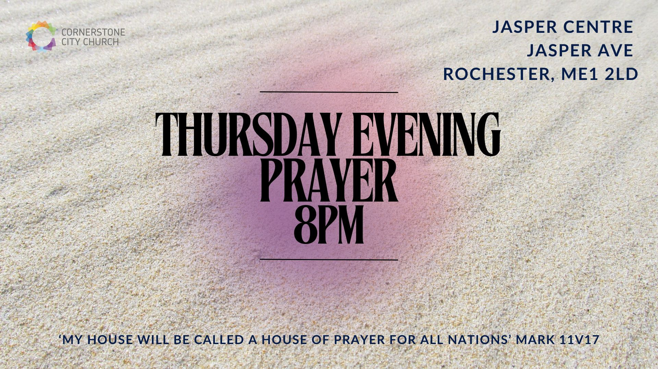

Slide 43


